Slide 1
13.3 Activation functions

Slide 2
In principle one can use any function as an activation for a multi-layer perceptron.
For a while activations were chosen largely based on their biological plausibility, since this is the perspective in which neural networks themselves were largely regarded.
Today activation functions are chosen based on practical considerations like our ability to properly optimize multi-layer perceptron models which employ them as well as (of course) the general performance they provide.

Slide 3
Example: The step and sigmoid activations

Slide 4
Historically, biological neurons were thought to act somewhat like digital switches, being either completely 'on' or 'off' to transmitting information to connected cells.
This belief naturally led to the use of a *step function* taking on just two values: 0 (off) and 1 (on).
However this kind of step function leads to piece-wise flat cost functions which are extremely difficult to optimize using any local optimization technique.

Slide 5
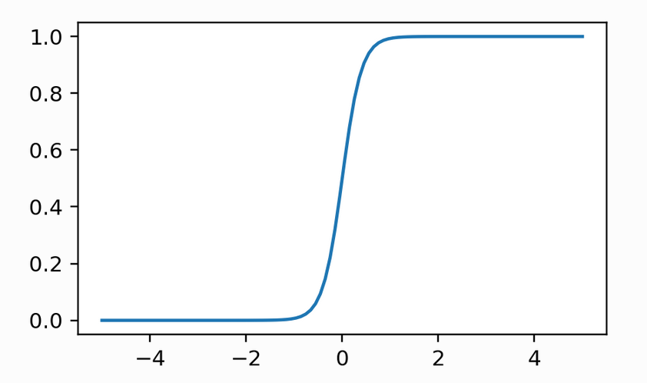
In the context of logistic regression, this issue of piece-wise flat cost functions is what led to the *logistic sigmoid* function, as a smooth approximation to the step function.
For the same reason the sigmoid function was one of the first popularly used activation functions, as a reasonable compromise between the desired neuronal model and the practical need to tune parameters properly.

Slide 6
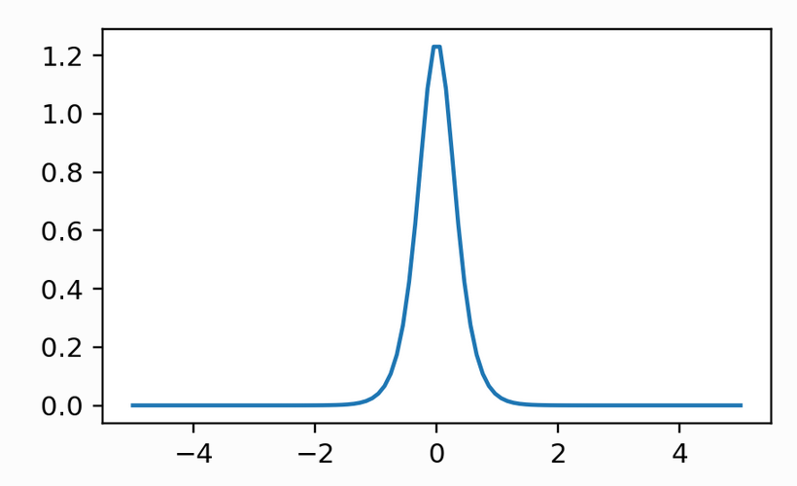
If we examine the derivative of a single-input sigmoid, we can see that any large (negative or positive) value passed through the derivative of the sigmoid is mapped to a value near zero.
When used as activation in a multi-layer perceptron this potential problem can synergize across its presence in many units and layers, particularly when normalization schemes are not employed, and cause the gradient of a model employing such a network to *vanish* unexpectedly.

Slide 7
Example: The rectified linear unit (ReLU) activation

Slide 8

A simpler function than a sigmoid (which involves both the use of a and exponential function), the ReLU function (and its relatives) have quickly become the most popular activation functions in use today.
The ReLU function does not suffer from the same sort of vanishing gradient problem that the sigmoid does, as its derivative only maps negative values to zero.

Slide 9
However, some care still must be taken when initializing and training a network employing ReLU activations.
For example, a multi-layer perceptron employing ReLU activations should be initialized away from the origin to avoid too many of the units (and their gradients) from vanishing.

Slide 10
Example: The maxout activation

Slide 11
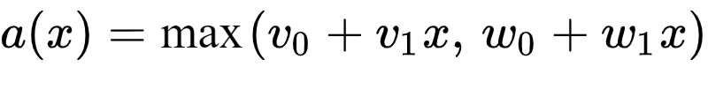
The *maxout* activation is a relative of the ReLU that takes the maximum of two linear combinations of the input (instead of one linear combination and zero, as is the case with ReLU)

Slide 12
Four instances of such a maxout unit are plotted below, in each instance its parameters are chosen at random.

Slide 13
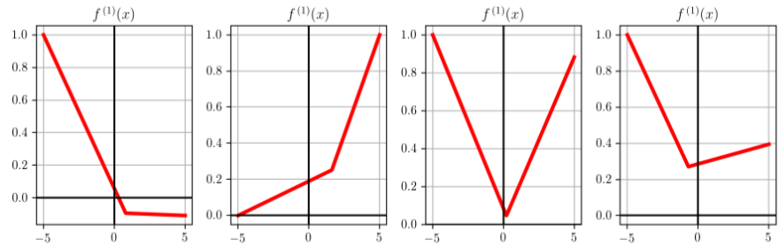

Slide 14

Multi-layer perceptron architectures employing the maxout activation tend to have certain advantages over those employing and ReLU activations, including:
fewer issues with problematic initialization (e.g., values close to or equal to zero for the *ReLU* activation are bad because the relu is minimized at zero)
fewer issues with gradients vanishing
empirically faster convergence with far fewer gradient descent steps
These advantages come with a simple price: the maxout activation has twice as many internal parameters as either the ReLU or

